Slide 1
User Document
E-Separation:

Slide 2
E-Separation:
E-Separation process can be initiated by Employee and/or Manager/HR
Self Initiation:
Employees can themselves apply for a Resignation by clicking on Request Icon
and selecting E-Resign which will open a pop up displaying Self Resignation Form

Slide 3
Employees need to fill up below form and click on Submit
Once the record is submitted, it goes through the Approval Process

Slide 4
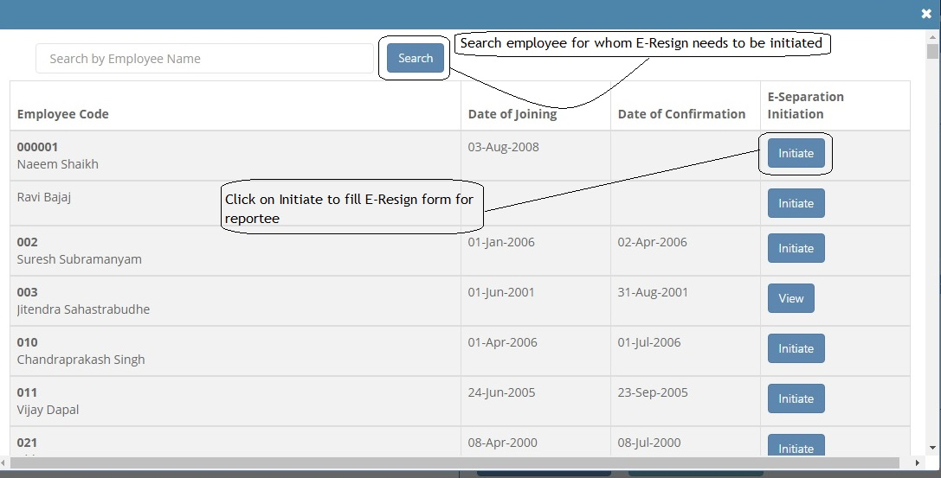
Manager Initiation:
Managers have the option to initiate Separation for their Reportees
To access this, Managers need to click on Request for Icon and select Manager Initiation

Slide 5
A pop up opens displaying list of employees mapped to the Manager with an option
to initiate their E-Resignation
Once we click on initiate, Manager gets the view of Resignation form which they have to fill in
and submit for initiating separation for selected employee

Slide 6
Approval Process:
Managers need to click on Notification Bell Icon to view all pending records
and/or approve pending transactions
Click on a record to view the transaction form for E-Separation

Slide 7
Proceed ahead to fill up the form as per requirement and mandatory fields

Slide 8
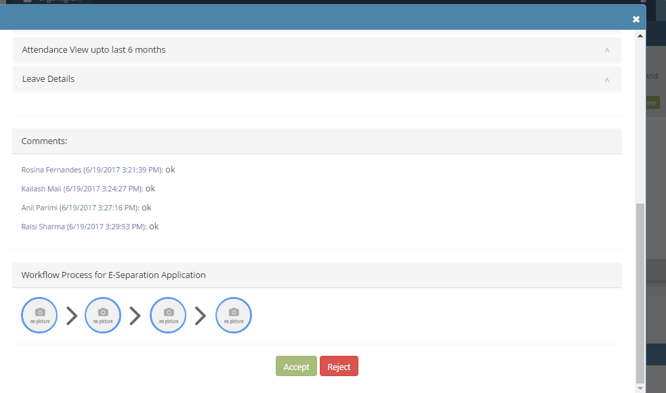
Click on Approve/Reject to perform acceptance or rejection of a transaction

Slide 9
Checklist:
Checklist Manager will get their notification of checklist items which will trigger after manager take action on E-sep transaction or throgh job.
He/She can View Pending Checklist Details from Notification Icon

Slide 10
E-Separation Dashboard:
E-Separation Dashboard can be accessed by clicking on ELC from left hand side menu
Dashboard displays counts of records ending in transaction workflow

Slide 11
HR can access various reports from this dashboard and/or go to settings screen

Slide 12
Thank You

